Slide 1

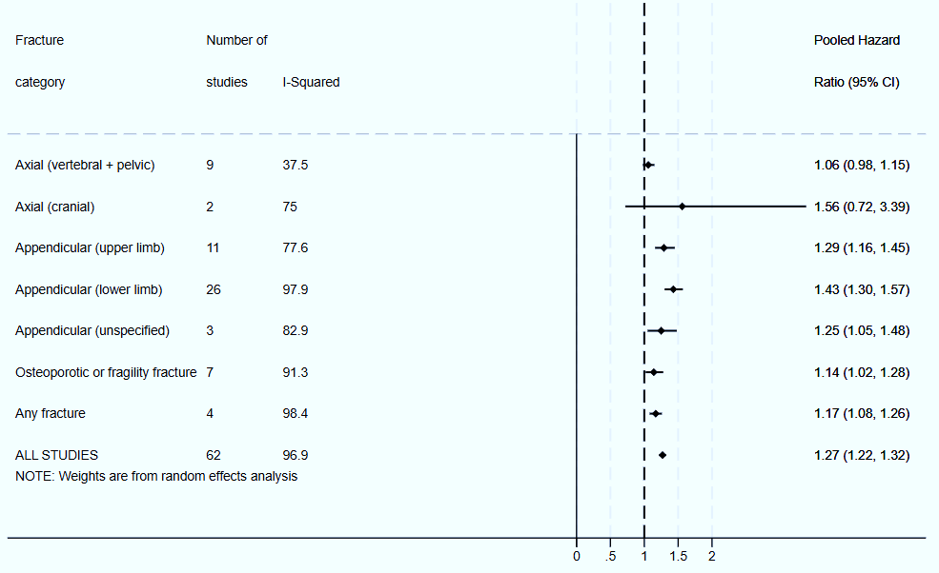





Association Between Type 2 Diabetes and Fracture Risk: Site-specific Differences – A Systematic Review and Meta-analysis of Cohort Studies
Sara Naderpour ¹, Clare Gillies ², Paul O’Riordan ³, Zahra Karimi ² , Malihe Khoramdad ⁴, Sonia Khavere ¹, Monica Kundu ^{1,} , Safoora Gharibzadeh ²
1. Ph.D student in Epidemiology, Population of Health Science, University of Leicester, LE1 7RH, UK
2. Leicester Real World Evidence Unit, Diabetes Research Centre, Leicester General Hospital, University of Leicester, Leicester, LE5 4PW, UK
3. Department of respiratory sciences, University of Leicester, Leicester, UK
4. Assistant Professor in Epidemiology, Social Health Research Institute, University of Social Welfare and Rehabilitation Sciences, Tehran, Iran
Introduction
Method
Background
Type 2 diabetes is associated with an increased risk of fracture; however, the impact of T2DM and subsequent fracture at different sites remains inconclusive.
Objective
Determine the risk of fractures in adults with T2D vs. non-diabetic individuals, across different fracture sites
Based on MOOSE guidelines
Registered with PROSPERO (CRD42024548795)
Databases searched: Medline, Embase, CINAHL, Web of Science (up to June 7, 2024)
Two reviewers independently undertook study selection, quality assessment and data extraction into pre-defined form
Result
Forest plot of fracture risk in various site fractures
PRISMA flow chart
Risk of fracture in various site fractures
Total fracture risk: 1,140,798 fractures reported across 21 studies (35.1 million individuals)
Pooled Hazard Ratio (HR): 1.27 (95% CI: 1.22–1.32) → 27% increased fracture risk in T2D.
Appendicular (Lower Limb) Fractures: 43% significant increased risk
Appendicular (Upper Limb) Fractures: 29% significant increased risk
Appendicular (Unspecified) Fractures: 20% significant increased risk
Any Fracture: 17% significant increased risk
Osteoporotic/Fragility Fractures: 14% significant increased risk
Summary of study characteristics
Study Designs: 14 prospective, 4 retrospective (population-based), 2 retrospective(hospital-based)
Geographical Regions: North America, Europe, Asia, and Australia
Mean Age Range: 53.96 to 76.86 years
Ethnic Groups: White, Asian, and Mixed/Multiple ethnic groups
Follow-up Duration: 2.5 to 21 years
Quality Assessment: Most studies were of high quality (7-9 NOS score)
Meta-regression analysis assessed fracture risk variation across different fracture types
Male Percentage & Lower Limb Fractures
Inverse association: Higher male percentage → Lower fracture risk in lower limb fractures
Publication Year & Osteoporotic/Fragility Fractures
Positive association → More recent studies report higher fracture
Any Fracture: Negative association → Older studies report higher fracture risks
Follow-Up Time & "Any fracture"
"Any Fracture" category: Longer follow-up periods capture more fractures
Conclusion
Patients with T2D have a significantly higher risk of fractures compared to non-diabetic individuals, particularly in:
Upper and lower limbs
Non vertebral
Osteoporotic/fragility fractures
Any fracture
References
Scan QR code for references

