Slide 1

“We are too secretive – we need to talk about dementia: a Caribbean co-researcher’s vital contributions to dementia care research
Bettina Wallace, Research Affiliate
Orii McDermott, Senior Research Fellow
Institute of Mental Health, School of Medicine,
University of Nottingham
35th Alzheimer’s Europe Conference, Bologna, October 2025

Slide 2

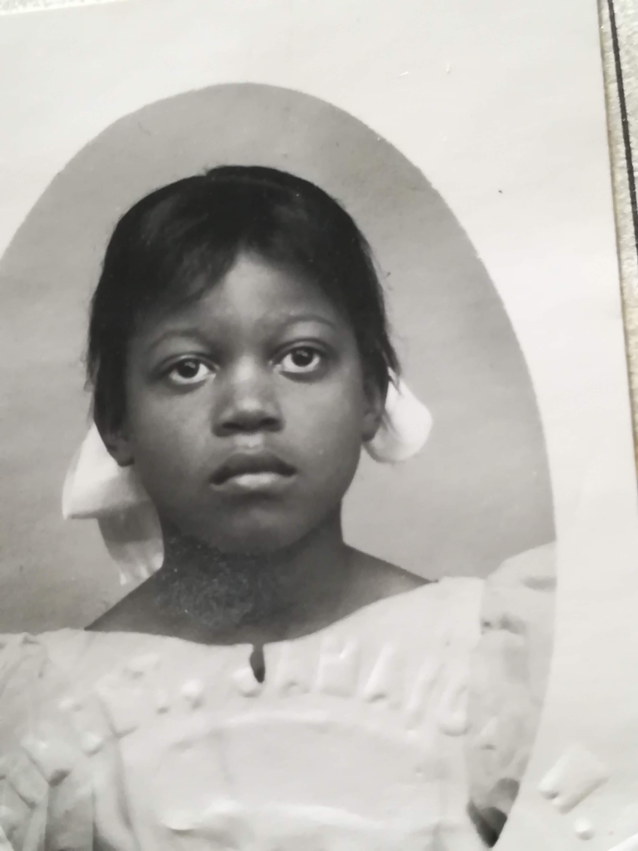

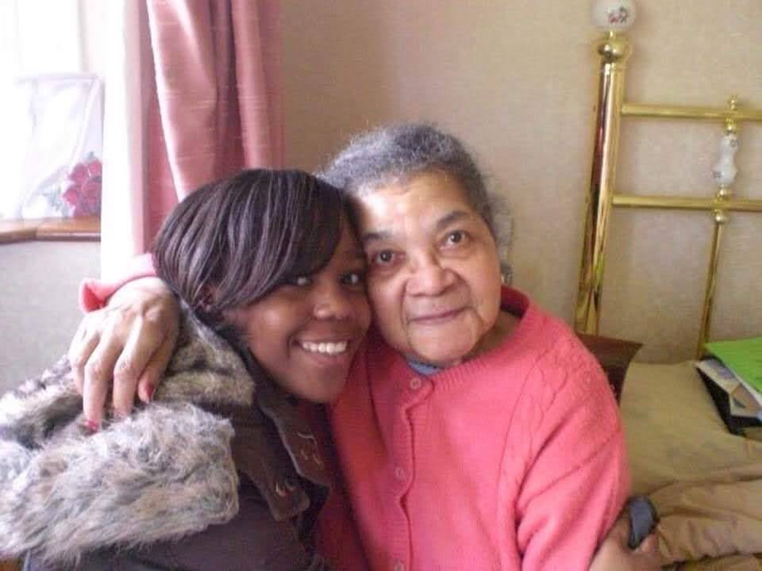

My background

Slide 3

Appointment as a Dem-Comm Co(mmunity)-Researcher
Previous involvement – time-limited work with the Institute of Mental Health dementia researchers
Orii’s appointment as a NIHR Dem-Comm Fellow in applied dementia care research
Bettina’s appointment as a long-term (2 years+) Dem-Comm Co-Researcher
Orii has already worked in dementia care as a clinician and a researcher for over 20 years
– so why was Bettina’s ongoing involvement as a co-researcher so crucial?
Trust, Community Link, then create opportunities (informal talks) to show university researchers can be trusted

Slide 4


Community response
What is in it for us?
We don’t talk our private business in public
What we really need is a culturally appropriate, local day service for Caribbean older people – not Research
After your talk, xx went to see their doctor

Slide 5
What I learnt from being a co-researcher for dementia research
It takes time to build up trusting relationships between community members and researchers
Members of the community will engage if they have someone like them speaking and supported by professionals
I may not be an expert, but I am a key messenger to link my community to dementia knowledge/ researchers
Being a co-researcher allowed me to question and challenge dementia organisations/ research groups how they engage with the black community
Opportunity to expand my research involvement – I became a co-applicant for the SPIN-D Network, extending my dementia knowledge and being involved in conference presentation and grants application evaluation
Challenge: lack of culturally appropriate dementia literature/ dementia care resources – difficult to convince Caribbean community members to use dementia support services if they cannot relate to the resources
Challenge: even though I am a well-respected/ connected community member, engaging Caribbean men from certain generations in health awareness talks, remains a challenge
Orii (Researcher)’s perspective – Poster tomorrow (8th Oct) “We’ll keep chipping away”: a joint learning journey for a Caribbean co-researcher and a university researcher to raise dementia awareness amongst Caribbean communities

Slide 6
Future Plans & Recommendations
Future plans for my development:
Develop my skills and research knowledge further by undertaking external courses, as well as participating in dementia training courses as part of my current role (e.g., Liv-Dem course, November 2025)
Building on my experience of working with UoN researchers, I have also started my own dementia initiative in Nottingham: Dementia Safe Space for African & Caribbean people, supported by CEO of a local cinema
Recommendations:
For Funders & Research Networks:
Longer-term support for community researchers – consider creating ‘Co-Researcher Fellowship’
Develop a network for community researchers for mutual support and learning opportunities
For Researchers/ University academics:
Talk to community members before you start making research plans.
Do not underestimate the time and efforts required to build trusting working relationships with any community. Deliver what you promise to deliver. Frequent communication and transparency is essential.
Consider offering more academic training and certificates to community researchers.

Slide 7

Thank you Bettina.Wallace@nottingham.ac.uk Orii.McDermott@nottingham.ac.uk

